Slide 1

Rules for Successful Improvisation

Slide 2
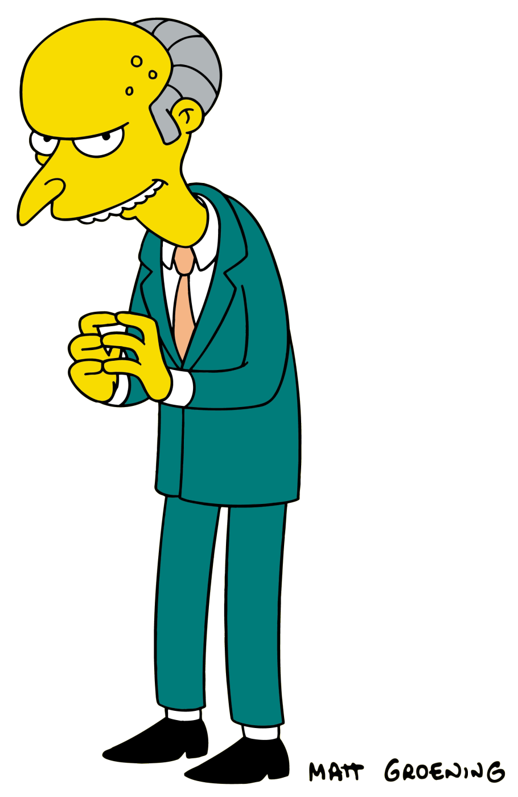
1. Define Your Character
Who am I? How will I use my
body and voice to convey
my character?
2. Stay in Character
Don’t laugh or change established characteristics.

Slide 3
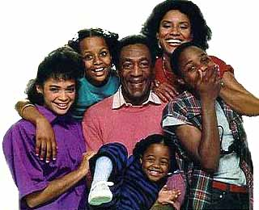
3. Establish Relationships
What is my relationship to the other characters in the scene? Clarify this
early in the scene.

Slide 4
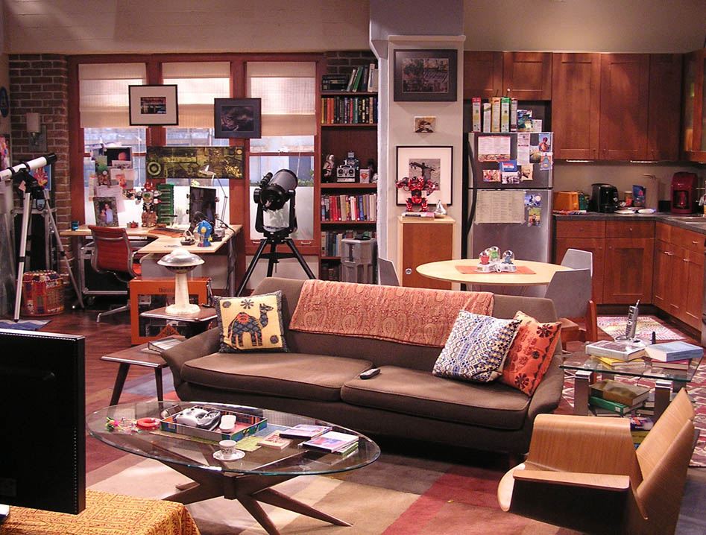
4. Establish the Location
Know where you are. Establish the location before beginning or early in the skit.

Slide 5
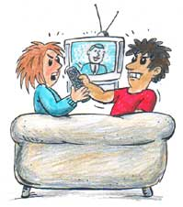
5. Know the Conflict
There must be a problem and obstacles to solving it.

Slide 6

6. Know your Objective
What is my goal in this scene? Know it and keep it in sight.

Slide 7

7. Be a Good Listener
You must play off the dialogue of other characters and respond to their lines.

Slide 8

8. Include Plenty of Action
The audience wants to see you doing something. Maintain energy throughout.
Pantomime scenery and props as needed.

Slide 9

9. Never Say “No”
Keep the scene in the positive rather than the negative. Go along with what the other characters introduce into the scene.

Slide 10
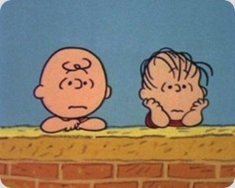
10. Reach a Conclusion!
If the audience is losing interest, you have let the scene drag on for too long.

